Slide 1
RESTFul API's do 0 à Nuvem Com ASP.NET Core 2.0 e Docker

Slide 2





Seção 01: Fundamentos Teóricos Do REST
Leandro Costa
http://www.erudio.com.br/
https://bit.ly/2IkHwoa
http://www.semeru.com.br/
https://hub.docker.com/u/leandrocgsi/
https://github.com/leandrocgsi/RestWithASP-NETUdemy

Slide 3
Seção 02: Fundamentos Teóricos Do REST
Leandro Costa
http://www.erudio.com.br/
https://bit.ly/2IkHwoa
http://www.semeru.com.br/
https://hub.docker.com/u/leandrocgsi/
https://github.com/leandrocgsi/RestWithASP-NETUdemy

Slide 4
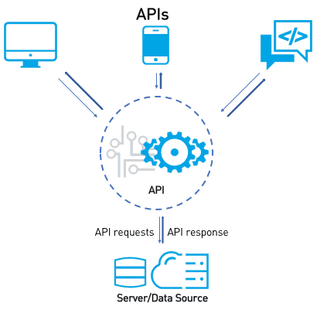
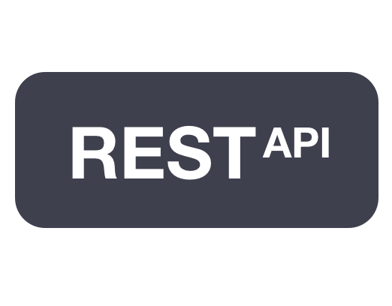




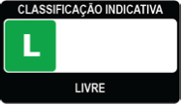

Slide 5
Recapitulando
O que são web-services?
SOAP x REST
Request e Response
Tipos de parâmetros
Status codes
Verbos
Níveis de maturidade
HATEOAS
Swagger
Autenticação
Versionamento
Indo além
Boas práticas

Slide 6
Seção 03: Configuração Do Ambiente No Windows
Leandro Costa
http://www.erudio.com.br/
https://bit.ly/2IkHwoa
http://www.semeru.com.br/
https://hub.docker.com/u/leandrocgsi/
https://github.com/leandrocgsi/RestWithASP-NETUdemy

Slide 7








Slide 8
Seção 04: Configuração Do Ambiente No Linux
Leandro Costa
http://www.erudio.com.br/
https://bit.ly/2IkHwoa
http://www.semeru.com.br/
https://hub.docker.com/u/leandrocgsi/
https://github.com/leandrocgsi/RestWithASP-NETUdemy

Slide 9





Slide 10
Seção 05: Primeiros Passos
Leandro Costa
http://www.erudio.com.br/
https://bit.ly/2IkHwoa
http://www.semeru.com.br/
https://hub.docker.com/u/leandrocgsi/
https://github.com/leandrocgsi/RestWithASP-NETUdemy

Slide 11




Slide 12
Recapitulando
Criação do Repositório no Github
Clone na nossa máquina
Scafold da primeira aplicação
Versionamento do código
Noções básicas de GIT

Slide 13
Recapitulando
Criação do Repositório no Github
Clone na nossa máquina
Scafold da primeira aplicação
Versionamento do código
Noções básicas de GIT

Slide 14
Seção 06: Implementando Uma Calculadora
Leandro Costa
http://www.erudio.com.br/
https://bit.ly/2IkHwoa
http://www.semeru.com.br/
https://hub.docker.com/u/leandrocgsi/
https://github.com/leandrocgsi/RestWithASP-NETUdemy

Slide 15


Slide 16
Recapitulando
Criação do Repositório no Github
Clone na nossa máquina
Scafold da primeira aplicação
Versionamento do código
Noções básicas de GIT

Slide 17
Seção 07: Aprendendo Os Quatro Verbos Principais
Leandro Costa
http://www.erudio.com.br/
https://bit.ly/2IkHwoa
http://www.semeru.com.br/
https://hub.docker.com/u/leandrocgsi/
https://github.com/leandrocgsi/RestWithASP-NETUdemy

Slide 18


Slide 19
Seção 08: Integrando A Aplicação Ao Banco De Dados
Leandro Costa
http://www.erudio.com.br/
https://bit.ly/2IkHwoa
http://www.semeru.com.br/
https://hub.docker.com/u/leandrocgsi/
https://github.com/leandrocgsi/RestWithASP-NETUdemy

Slide 20





Slide 21
Seção 09: Versionamento Da Nossa API
Leandro Costa
http://www.erudio.com.br/
https://bit.ly/2IkHwoa
http://www.semeru.com.br/
https://hub.docker.com/u/leandrocgsi/
https://github.com/leandrocgsi/RestWithASP-NETUdemy

Slide 22
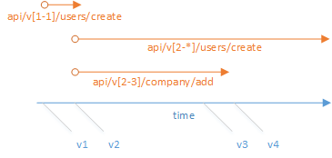

Slide 23
Seção 10: Adotando Uma Arquitetura Em Camadas
Leandro Costa
http://www.erudio.com.br/
https://bit.ly/2IkHwoa
http://www.semeru.com.br/
https://hub.docker.com/u/leandrocgsi/
https://github.com/leandrocgsi/RestWithASP-NETUdemy

Slide 24
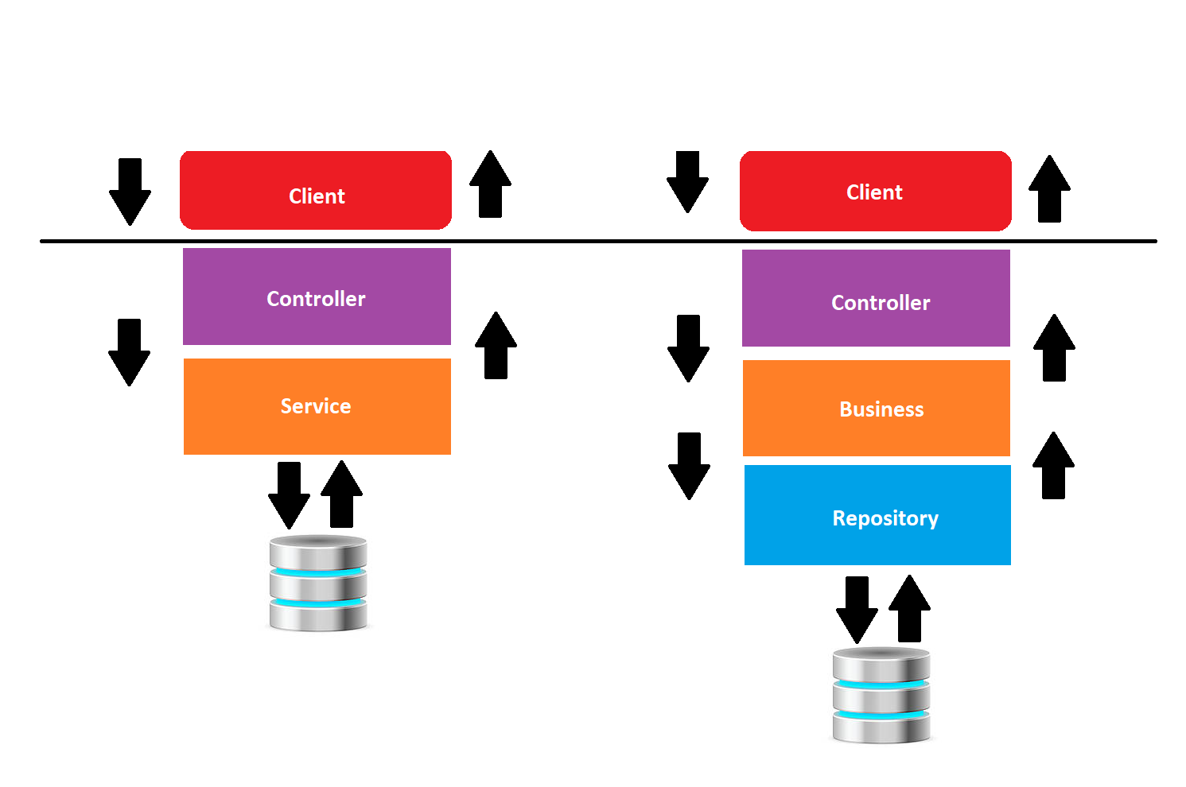

Slide 25
Seção 11: Migrations
Leandro Costa
http://www.erudio.com.br/
https://bit.ly/2IkHwoa
http://www.semeru.com.br/
https://hub.docker.com/u/leandrocgsi/
https://github.com/leandrocgsi/RestWithASP-NETUdemy

Slide 26
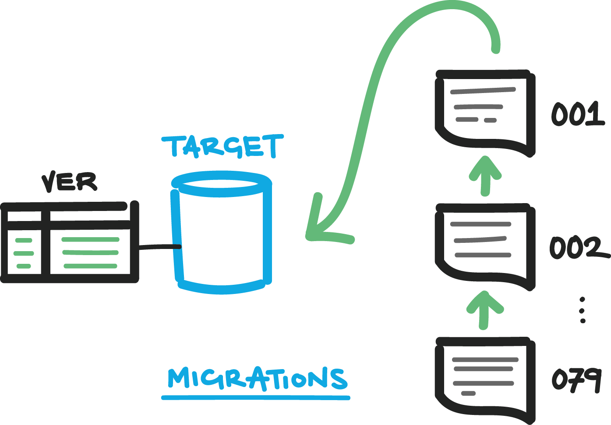


Slide 27
Seção 12: Padrão De Projeto Generic Repository
Leandro Costa
http://www.erudio.com.br/
https://bit.ly/2IkHwoa
http://www.semeru.com.br/
https://hub.docker.com/u/leandrocgsi/
https://github.com/leandrocgsi/RestWithASP-NETUdemy

Slide 28
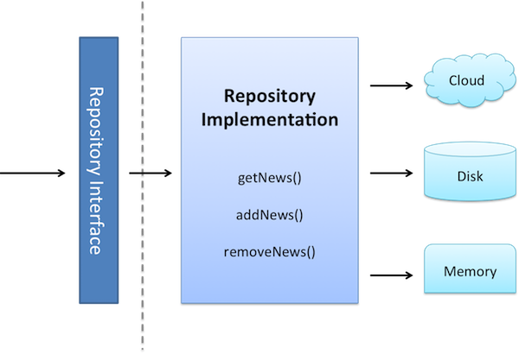

Slide 29
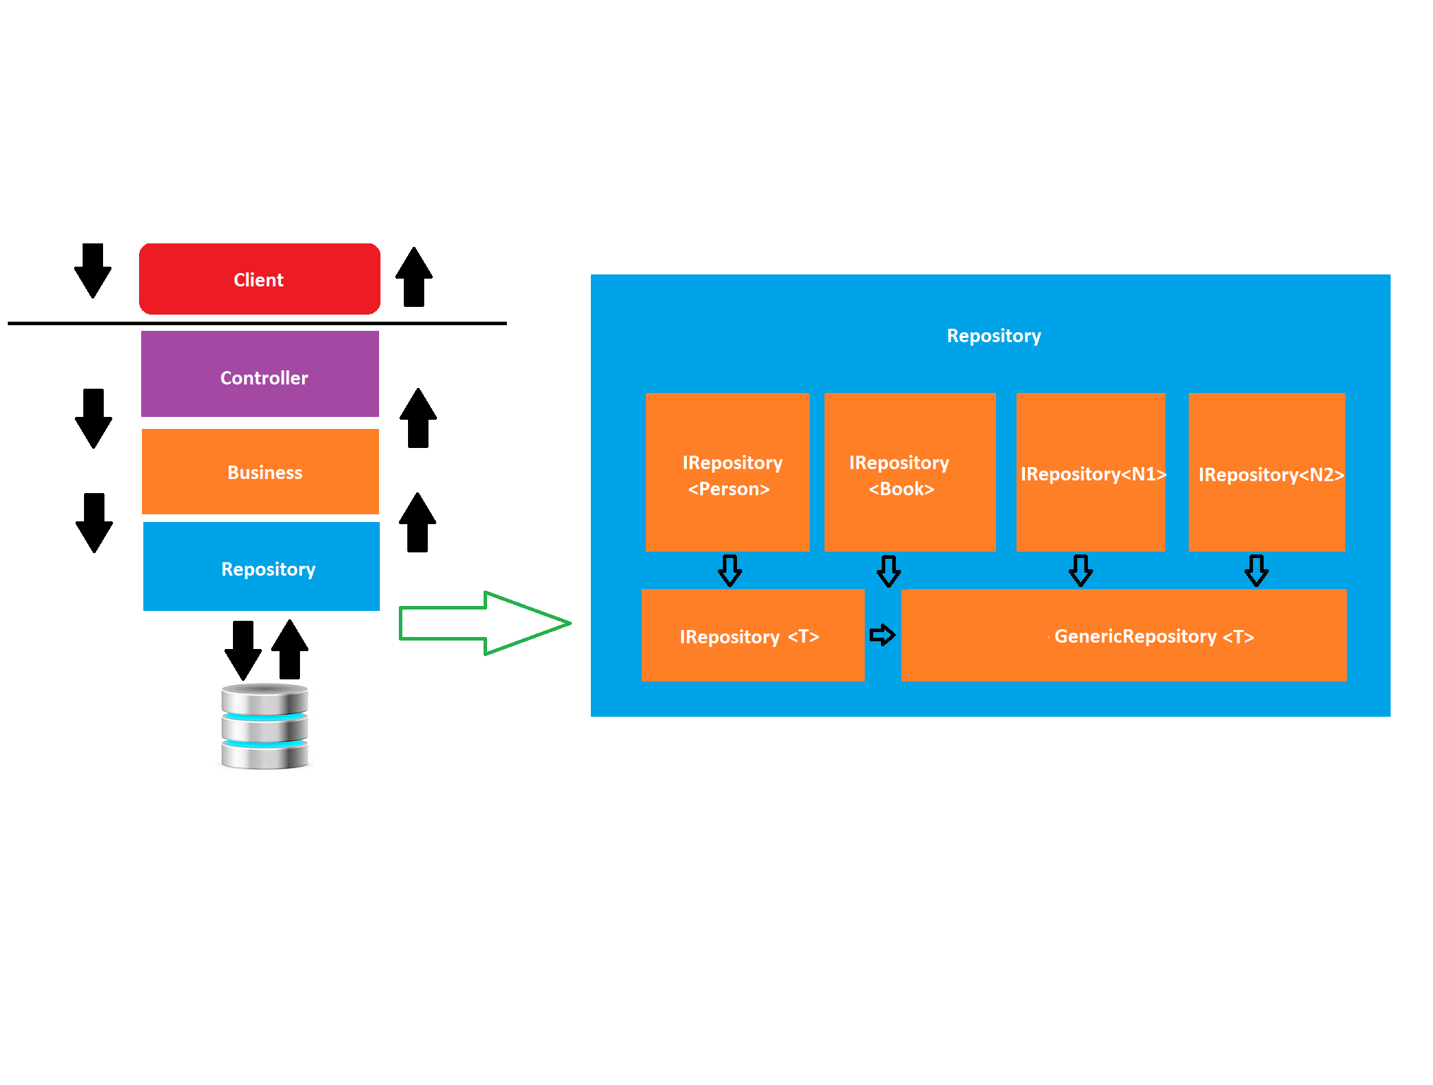

Slide 30
Seção 13: Padrão De Projeto Value Object (VO)
Leandro Costa
http://www.erudio.com.br/
https://bit.ly/2IkHwoa
http://www.semeru.com.br/
https://hub.docker.com/u/leandrocgsi/
https://github.com/leandrocgsi/RestWithASP-NETUdemy

Slide 31
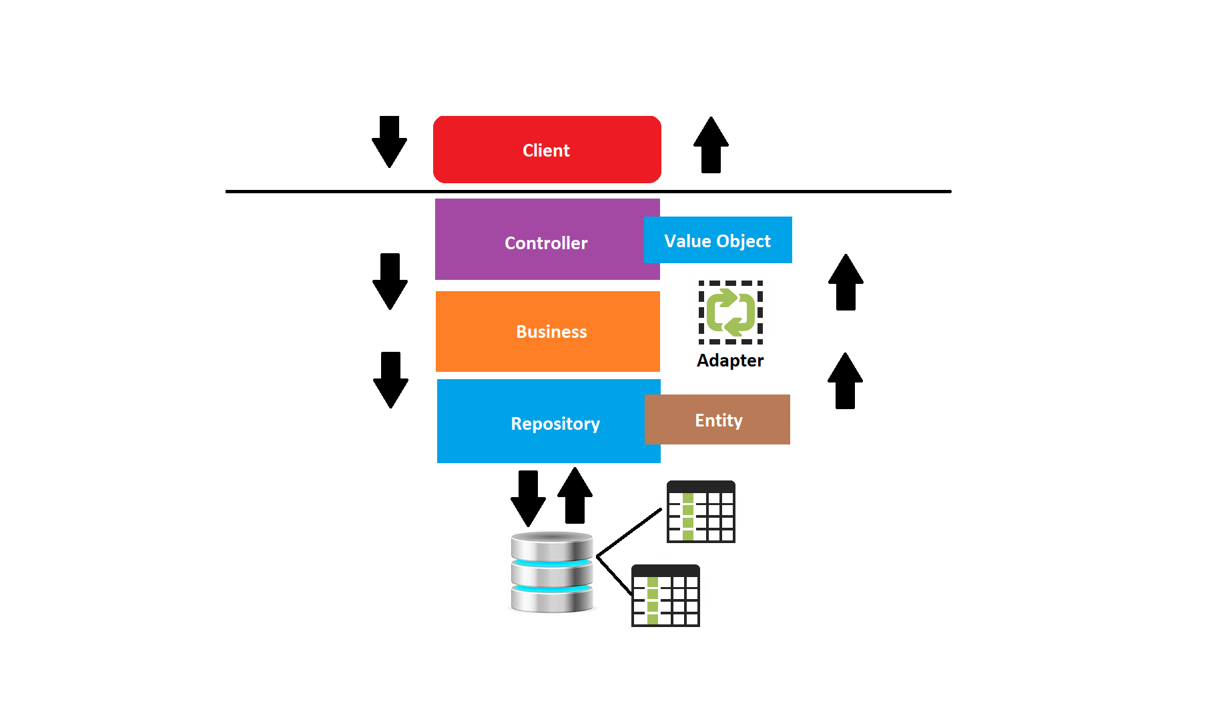

Slide 32
Seção 14: Data Contract
Leandro Costa
http://www.erudio.com.br/
https://bit.ly/2IkHwoa
http://www.semeru.com.br/
https://hub.docker.com/u/leandrocgsi/
https://github.com/leandrocgsi/RestWithASP-NETUdemy

Slide 33
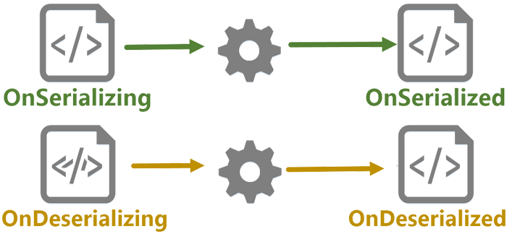

Slide 34
Seção 15: Content Negociation
Leandro Costa
http://www.erudio.com.br/
https://bit.ly/2IkHwoa
http://www.semeru.com.br/
https://hub.docker.com/u/leandrocgsi/
https://github.com/leandrocgsi/RestWithASP-NETUdemy

Slide 35





Slide 36
Seção 16: HATEOAS
Leandro Costa
http://www.erudio.com.br/
https://bit.ly/2IkHwoa
http://www.semeru.com.br/
https://hub.docker.com/u/leandrocgsi/
https://github.com/leandrocgsi/RestWithASP-NETUdemy

Slide 37


Slide 38
Seção 17: Swagger
Leandro Costa
http://www.erudio.com.br/
https://bit.ly/2IkHwoa
http://www.semeru.com.br/
https://hub.docker.com/u/leandrocgsi/
https://github.com/leandrocgsi/RestWithASP-NETUdemy

Slide 39



Slide 40
Seção 18: Autenticação
Leandro Costa
http://www.erudio.com.br/
https://bit.ly/2IkHwoa
http://www.semeru.com.br/
https://hub.docker.com/u/leandrocgsi/
https://github.com/leandrocgsi/RestWithASP-NETUdemy

Slide 41


Slide 42
Seção 19: O Verbo PATH
Leandro Costa
http://www.erudio.com.br/
https://bit.ly/2IkHwoa
http://www.semeru.com.br/
https://hub.docker.com/u/leandrocgsi/
https://github.com/leandrocgsi/RestWithASP-NETUdemy

Slide 43
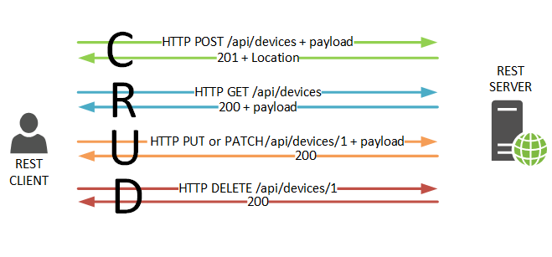

Slide 44
Seção 20: Query Params E Busca Paginada
Leandro Costa
http://www.erudio.com.br/
https://bit.ly/2IkHwoa
http://www.semeru.com.br/
https://hub.docker.com/u/leandrocgsi/
https://github.com/leandrocgsi/RestWithASP-NETUdemy

Slide 45
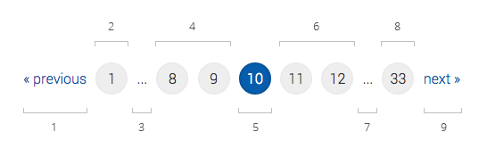

Slide 46
Seção 21: Trabalhando Com Arquivos
Leandro Costa
http://www.erudio.com.br/
https://bit.ly/2IkHwoa
http://www.semeru.com.br/
https://hub.docker.com/u/leandrocgsi/
https://github.com/leandrocgsi/RestWithASP-NETUdemy

Slide 47
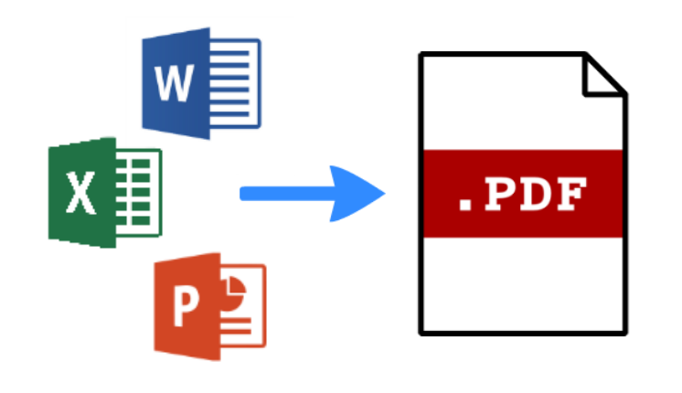

Slide 48
Seção 22: Adicionando Suporte Ao Docker
Leandro Costa
http://www.erudio.com.br/
https://bit.ly/2IkHwoa
http://www.semeru.com.br/
https://hub.docker.com/u/leandrocgsi/
https://github.com/leandrocgsi/RestWithASP-NETUdemy

Slide 49

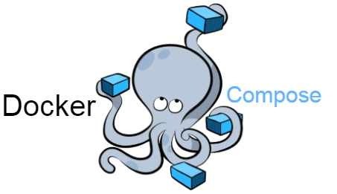


Slide 50
Seção 23: Deploy Na Azure
Leandro Costa
http://www.erudio.com.br/
https://bit.ly/2IkHwoa
http://www.semeru.com.br/
https://hub.docker.com/u/leandrocgsi/
https://github.com/leandrocgsi/RestWithASP-NETUdemy

Slide 51


Slide 52
O Padrão de Projetos Repository

Slide 53
Generic Repository

Slide 54
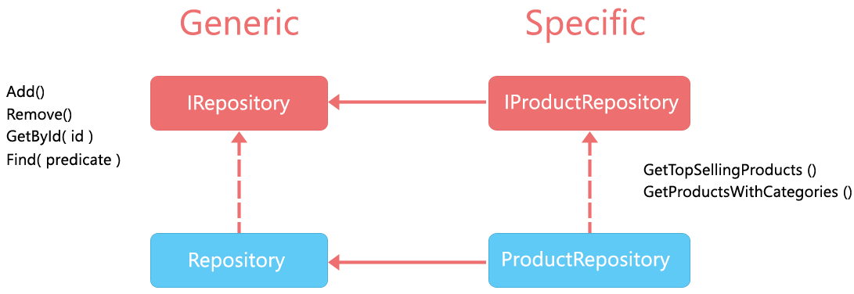

Slide 55
Referências
http://www.dotnetcurry.com/aspnet-mvc/1155/aspnet-mvc-repository-pattern-perform-database-operations
https://www.c-sharpcorner.com/UploadFile/8a67c0/repository-pattern-and-generic-repository-pattern/
http://www.tugberkugurlu.com/archive/generic-repository-pattern-entity-framework-asp-net-mvc-and-unit-testing-triangle
https://www.codeproject.com/Articles/814768/CRUD-Operations-Using-the-Generic-Repository-Patte
http://hannesdorfmann.com/android/evolution-of-the-repository-pattern

Slide 56
Referências
https://martinfowler.com/bliki/PresentationDomainDataLayering.html
https://msdn.microsoft.com/en-us/library/ee658109.aspx
https://msdn.microsoft.com/en-us/library/ff648105.aspx
https://en.wikipedia.org/wiki/Multitier_architecture
https://www.linkedin.com/learning/practical-application-architecture-with-entity-framework-core/multi-layer-applications

Slide 57
Referências
https://martinfowler.com/bliki/ValueObject.html
https://www.codeadventure.com/blog/why-you-should-use-value-objects
https://www.devmedia.com.br/diferenca-entre-os-patterns-po-pojo-bo-dto-e-vo/28162
https://imasters.com.br/artigo/7293/linguagens/padroes-de-projeto-value-object?trace=1519021197
[Generic Repository and Unit of Work Pattern, Entity Framework, Unit Testing, Autofac IoC Container and ASP.NET MVC](https://techbrij.com/generic-repository-unit-of-work-entity-framework-unit-testing-asp-net-mvc)
[HATEOAS](https://shatzisblog.wordpress.com/2017/09/01/generating-hypermedia-links-for-an-asp-net-core-web-api/)
[Pragmatic REST: APIs without hypermedia and HATEOAS](http://www.ben-morris.com/pragmatic-rest-apis-without-hypermedia-and-hateoas/)

Slide 58
Referências
https://msdn.microsoft.com/en-us/library/ff384251.aspx
https://nordicapis.com/introduction-to-api-versioning-best-practices/
http://www.patrickniezen.com/2016/2/11/api-versioning-with-mvc-6
https://www.troyhunt.com/your-api-versioning-is-wrong-which-is/
https://www.youtube.com/watch?v=55oIJuMUnDc

